Slide 1
SURPRISE HOUSE CASE STUDY
Likith Goshike
Data science intern
coincent

Slide 2
ABSTRACT
The "Surprise Housing" case study examines a unique residential development project aimed at addressing the critical issue of affordable housing in rapidly growing urban areas. This case study delves into the innovative strategies employed in the design, funding, and implementation of the Surprise Housing initiative. By analyzing the project's integration of sustainable practices, community involvement, and public-private partnerships, the study provides insights into its success factors and challenges. Key elements include the adaptation of modular construction techniques, use of green technologies, and the establishment of a robust stakeholder engagement process. The findings highlight how such a comprehensive approach can serve as a model for similar initiatives, offering valuable lessons for policymakers, developers, and community leaders in their efforts to create sustainable and inclusive housing solutions. The case study also identifies areas for improvement and future research to enhance the effectiveness of affordable housing projects.

Slide 3

HOUSing case study

Slide 4
OBJECtive
Determine the Influence of Key Variables: Assess how different independent variables—such as construction costs, design features, and stakeholder engagement—affect dependent variables such as affordability, resident satisfaction, and sustainability.
Identify Significant Predictors: Identify which factors are statistically significant predictors of project success metrics, including affordability and resident satisfaction, and quantify their effects.
Analyze Relationships between Variables: Explore the relationships between independent variables and project outcomes to understand how they interact and contribute to overall project effectiveness.
Evaluate Model Fit and Robustness: Assess the goodness-of-fit of the regression models to ensure they accurately represent the relationships between variables and provide reliable results.

Slide 5
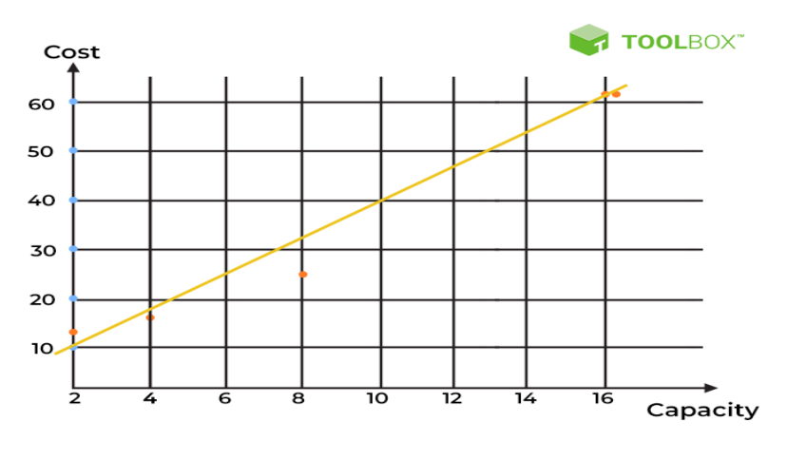
OBJECtive

Slide 6
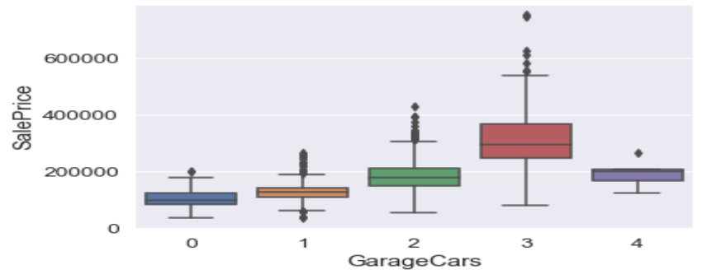
methodology

Slide 7
methodology
Data Preparation:
Data Cleaning: Review and clean data to handle missing values, outliers, and inconsistencies.
Data Transformation: Standardize variables and perform necessary transformations (e.g., log transformations for skewed data) to prepare for regression analysis.
Regression Analysis:
Multiple Linear Regression:: Use multiple linear regression to analyze the relationship between independent variables (e.g., construction costs, design features) and dependent variables (e.g., affordability, resident satisfaction).
Logistic Regression: Apply logistic regression if analyzing categorical outcomes, such as the likelihood of meeting sustainability criteria.

Slide 8
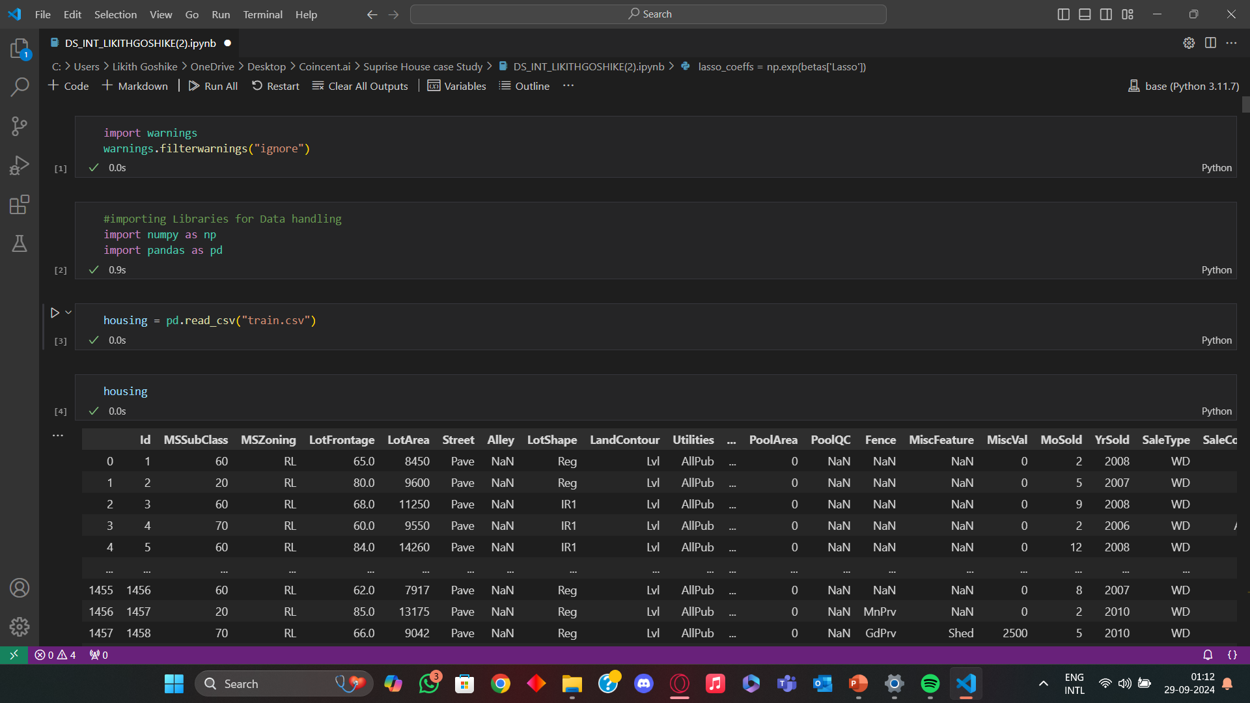
CODE

Slide 9
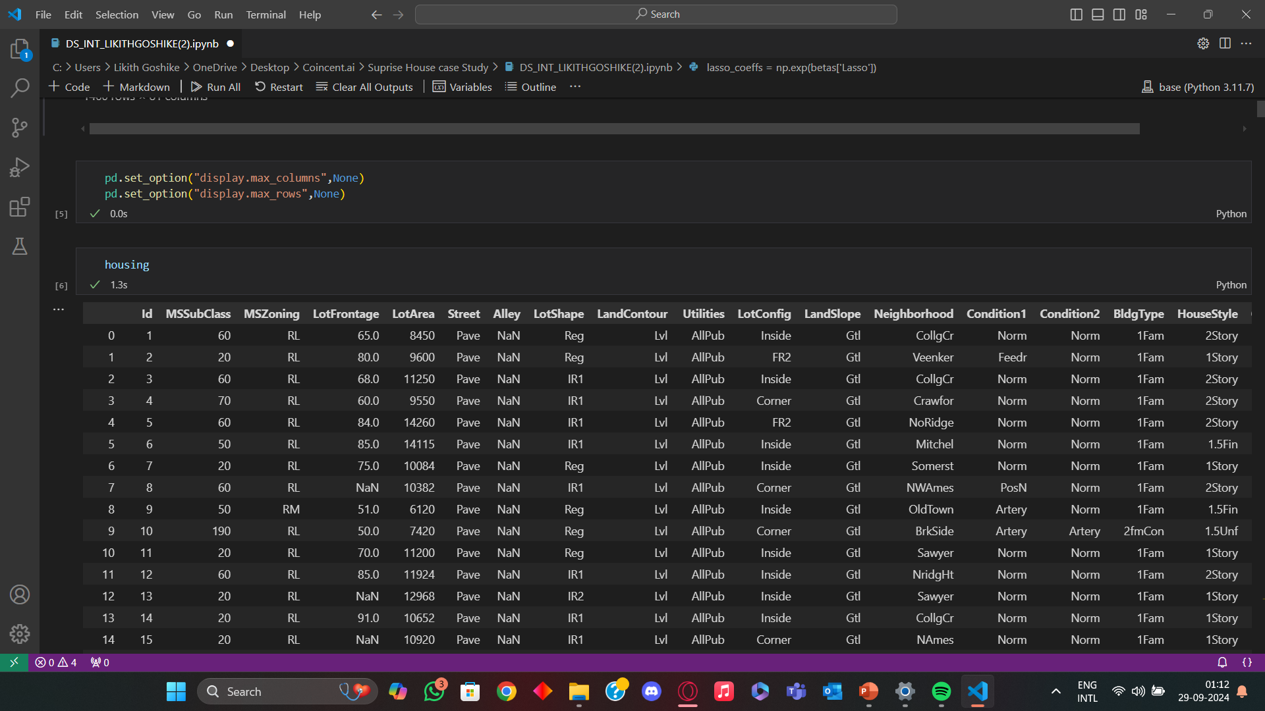
CODE

Slide 10
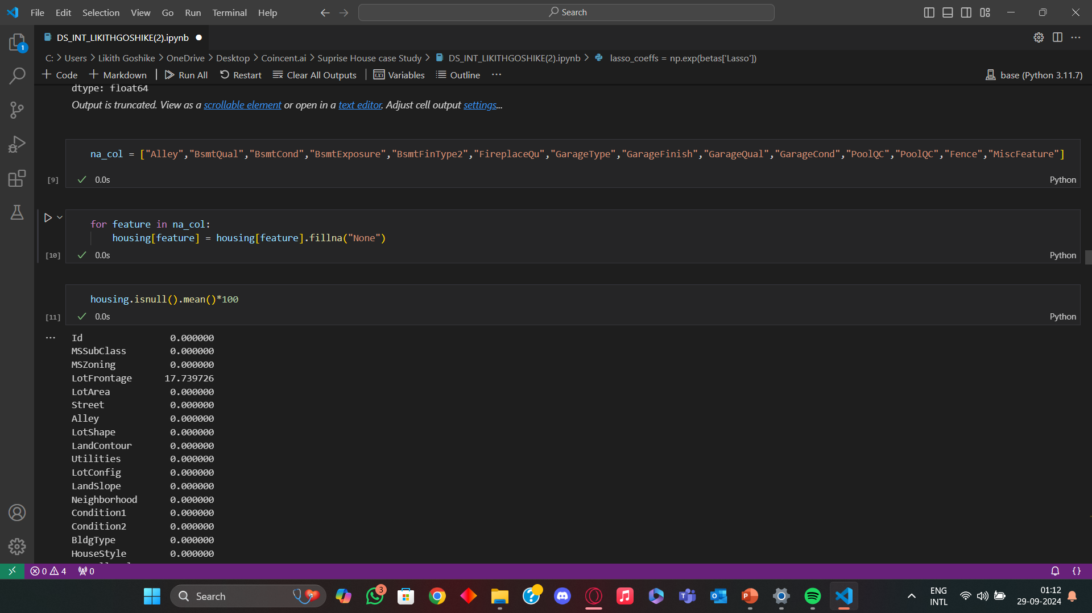
CODE

Slide 11
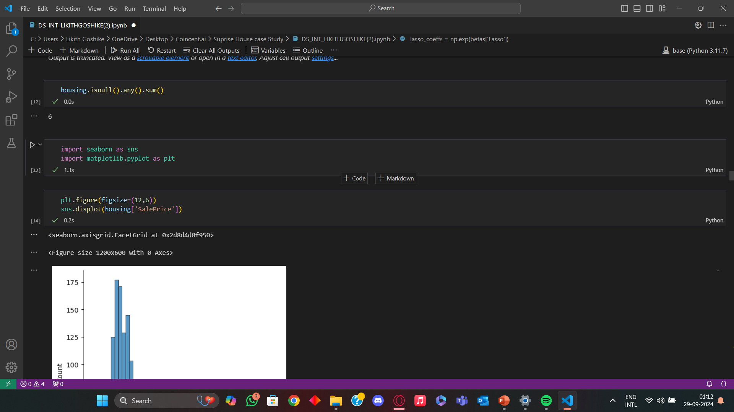
CODE

Slide 12
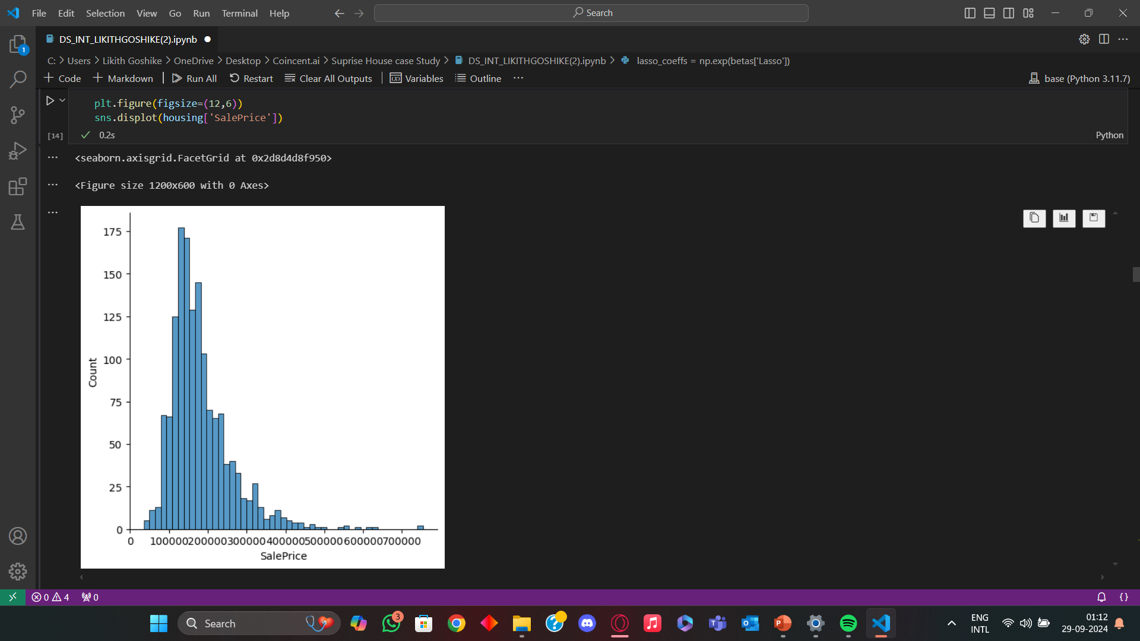
CODE

Slide 13
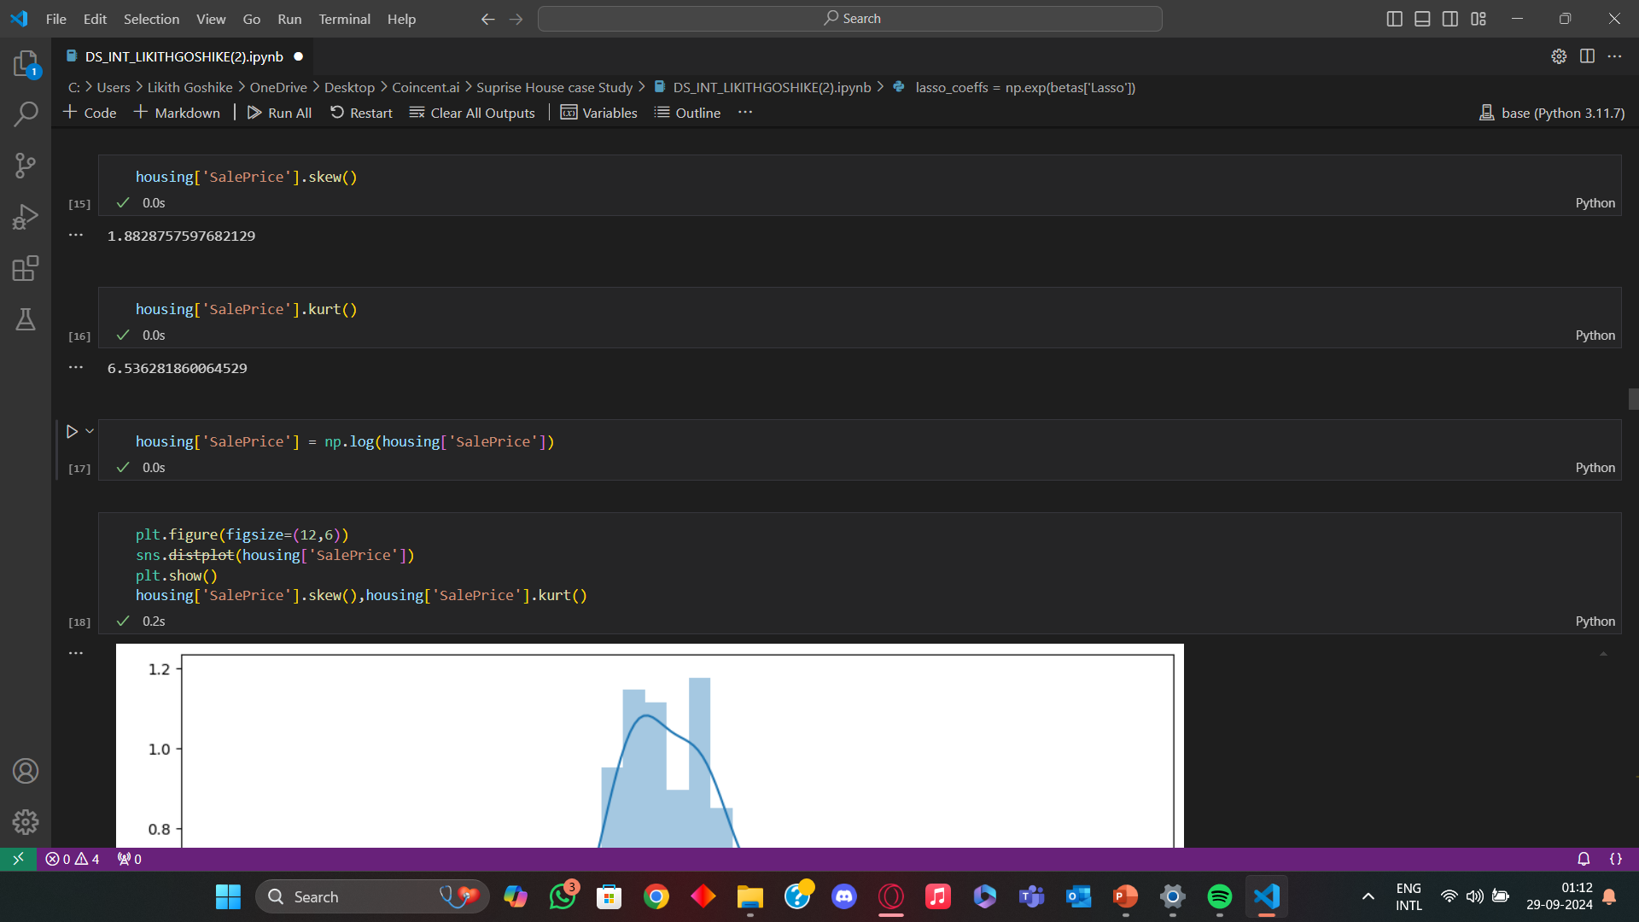
CODE

Slide 14
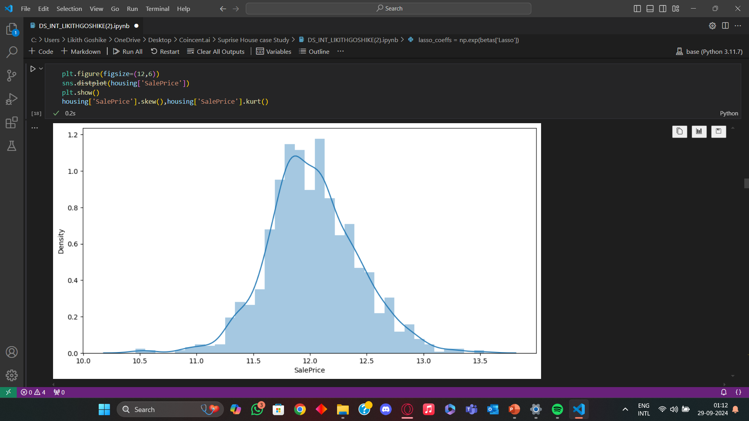
CODE

Slide 15

CODE

Slide 16
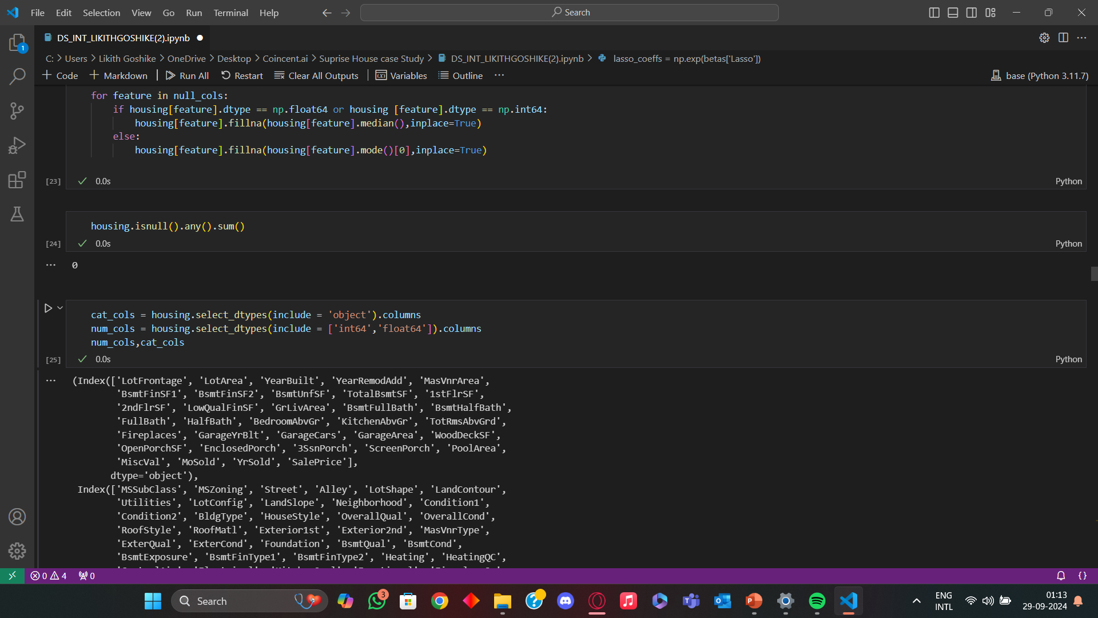
CODE

Slide 17
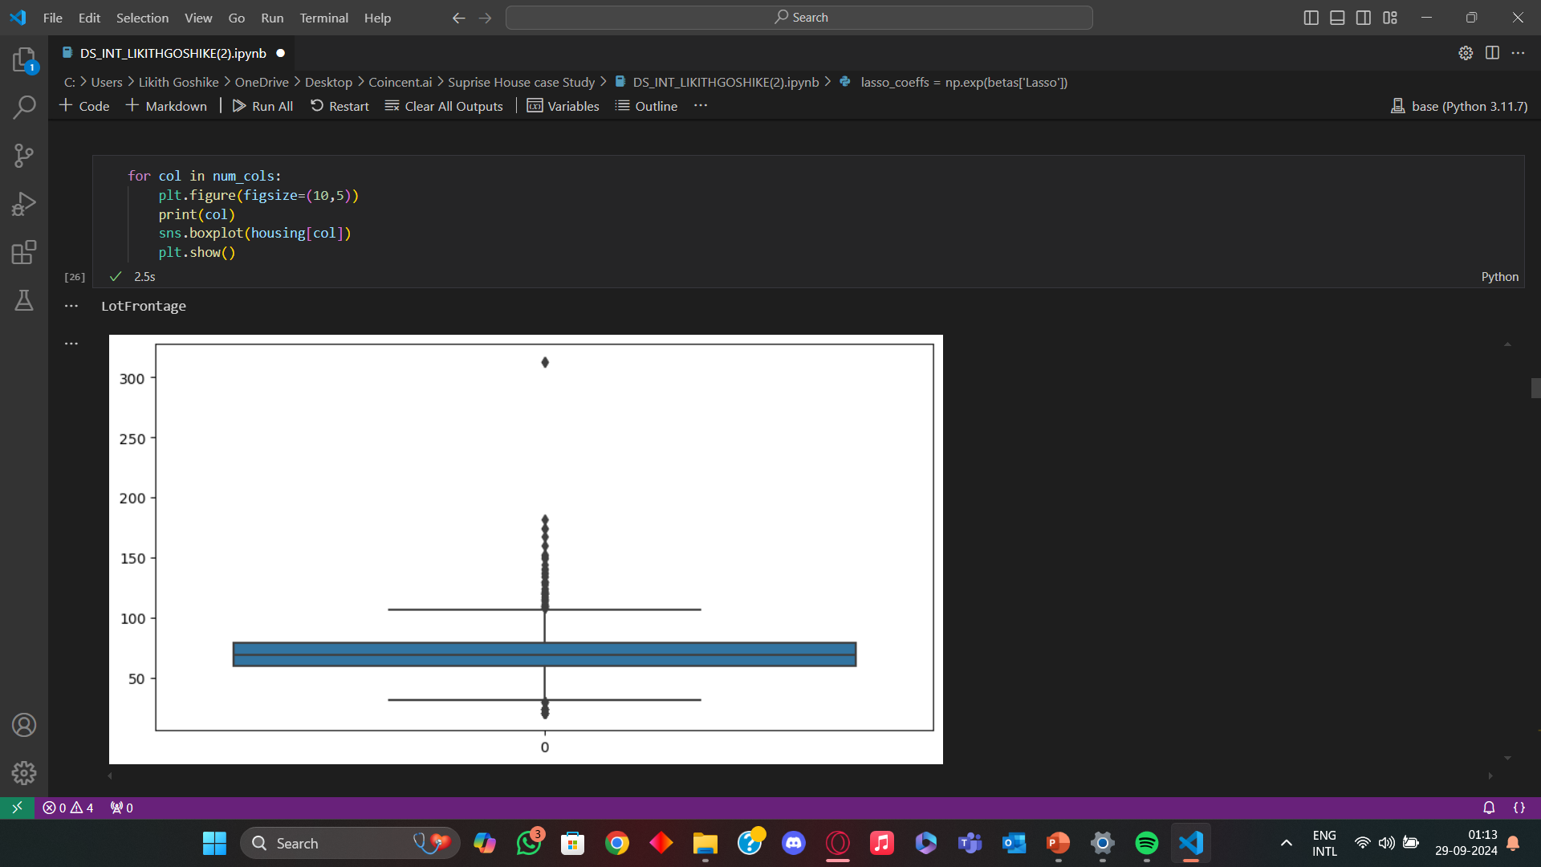
CODE

Slide 18
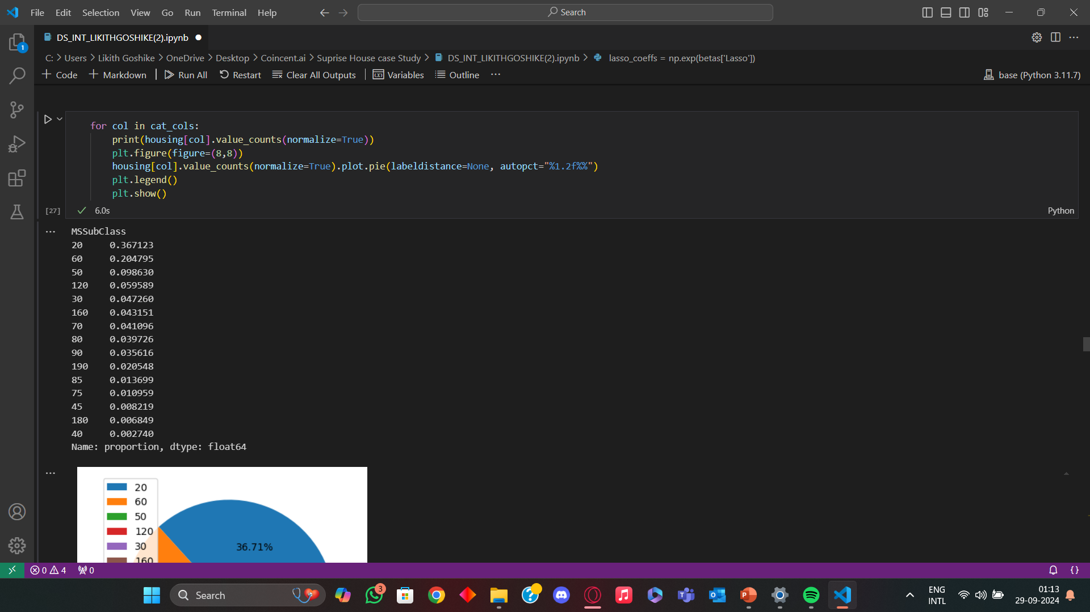
CODE

Slide 19
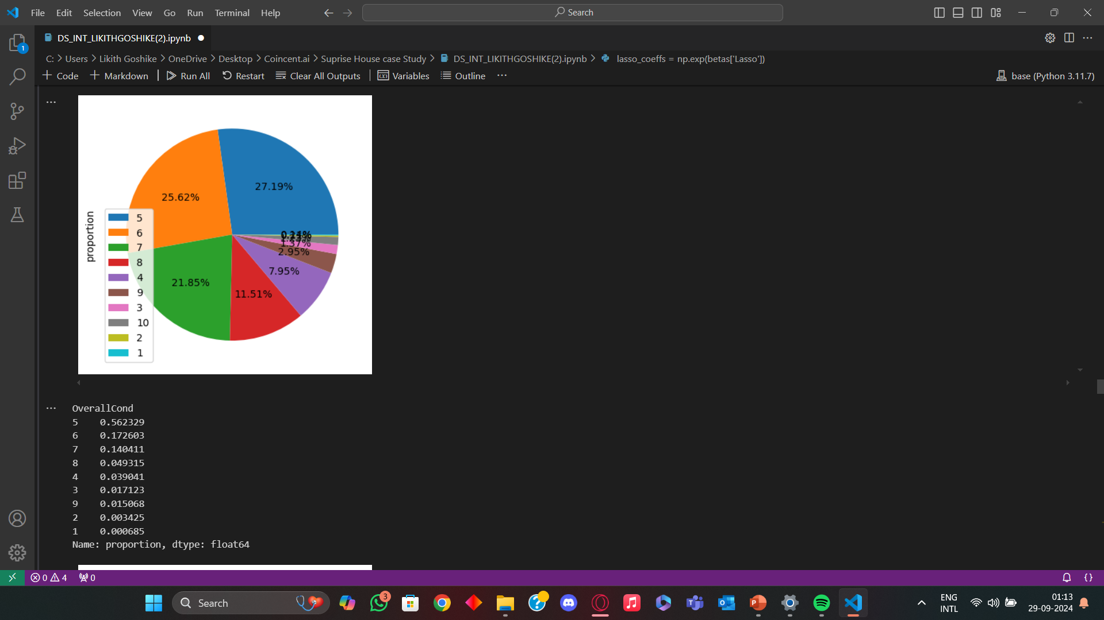
CODE

Slide 20
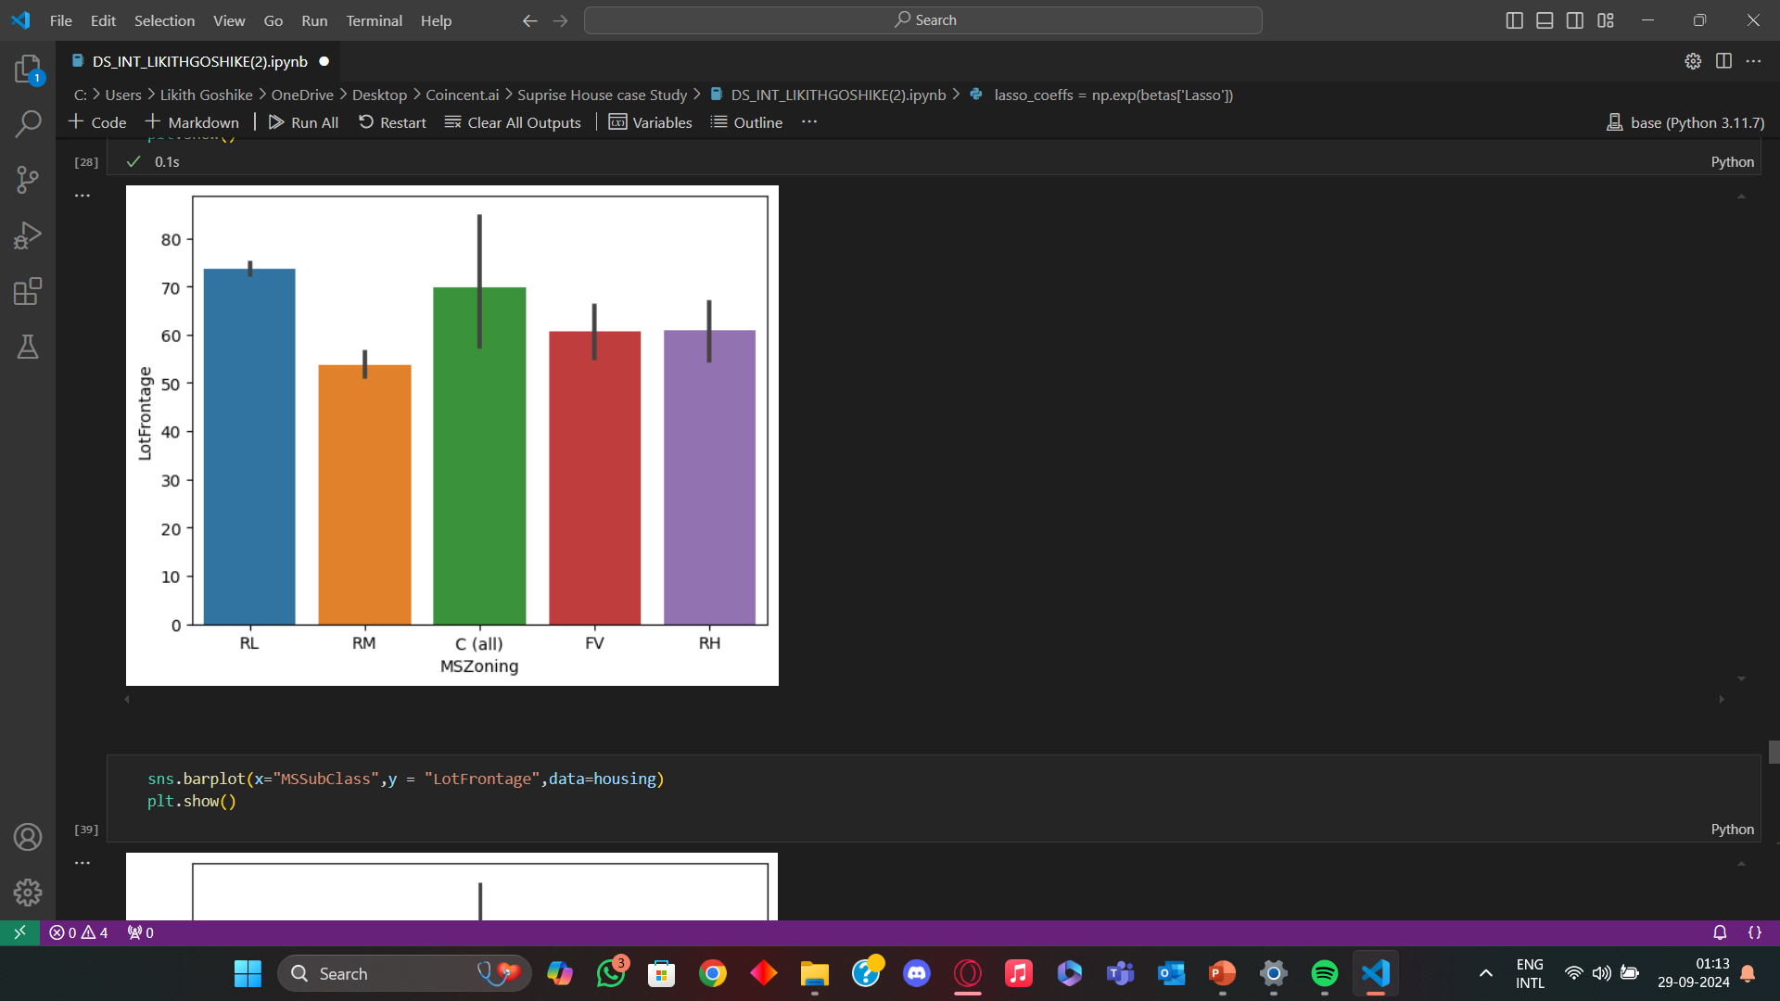
CODE

Slide 21
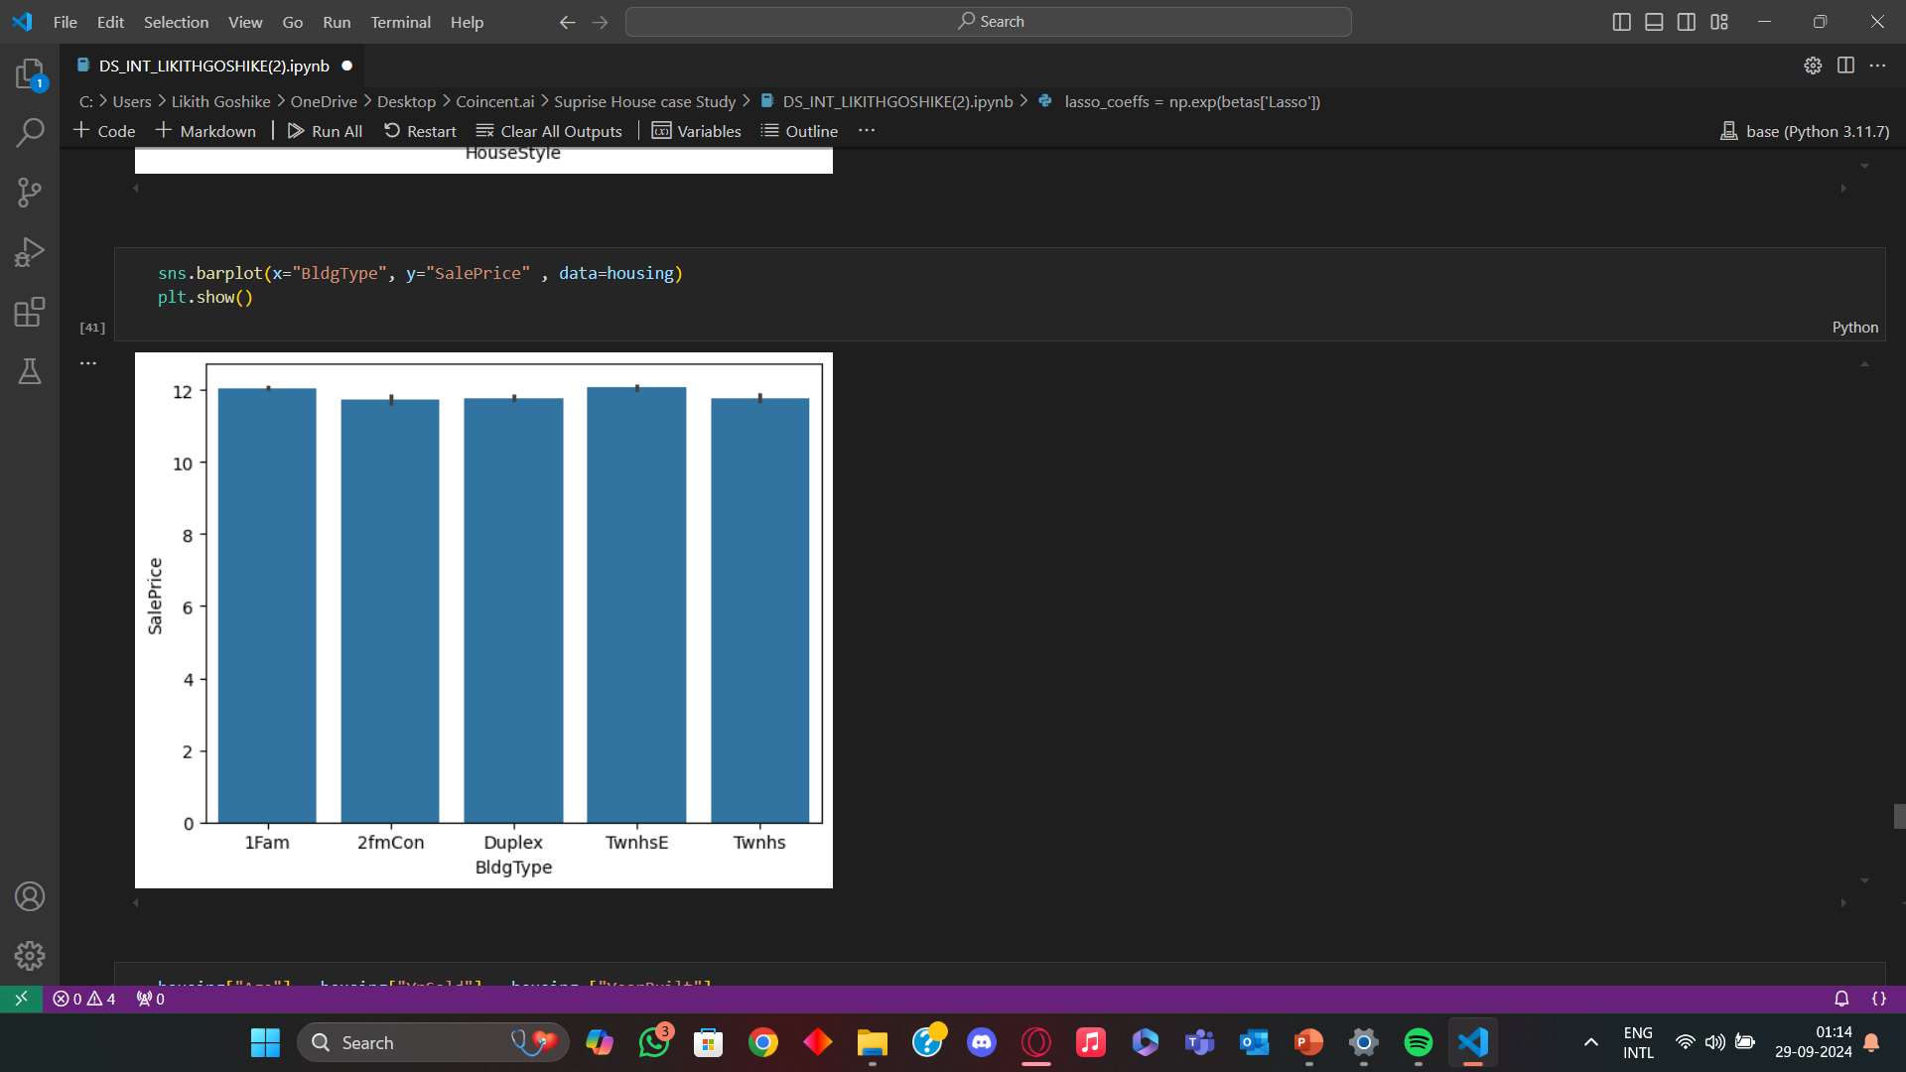
CODE

Slide 22
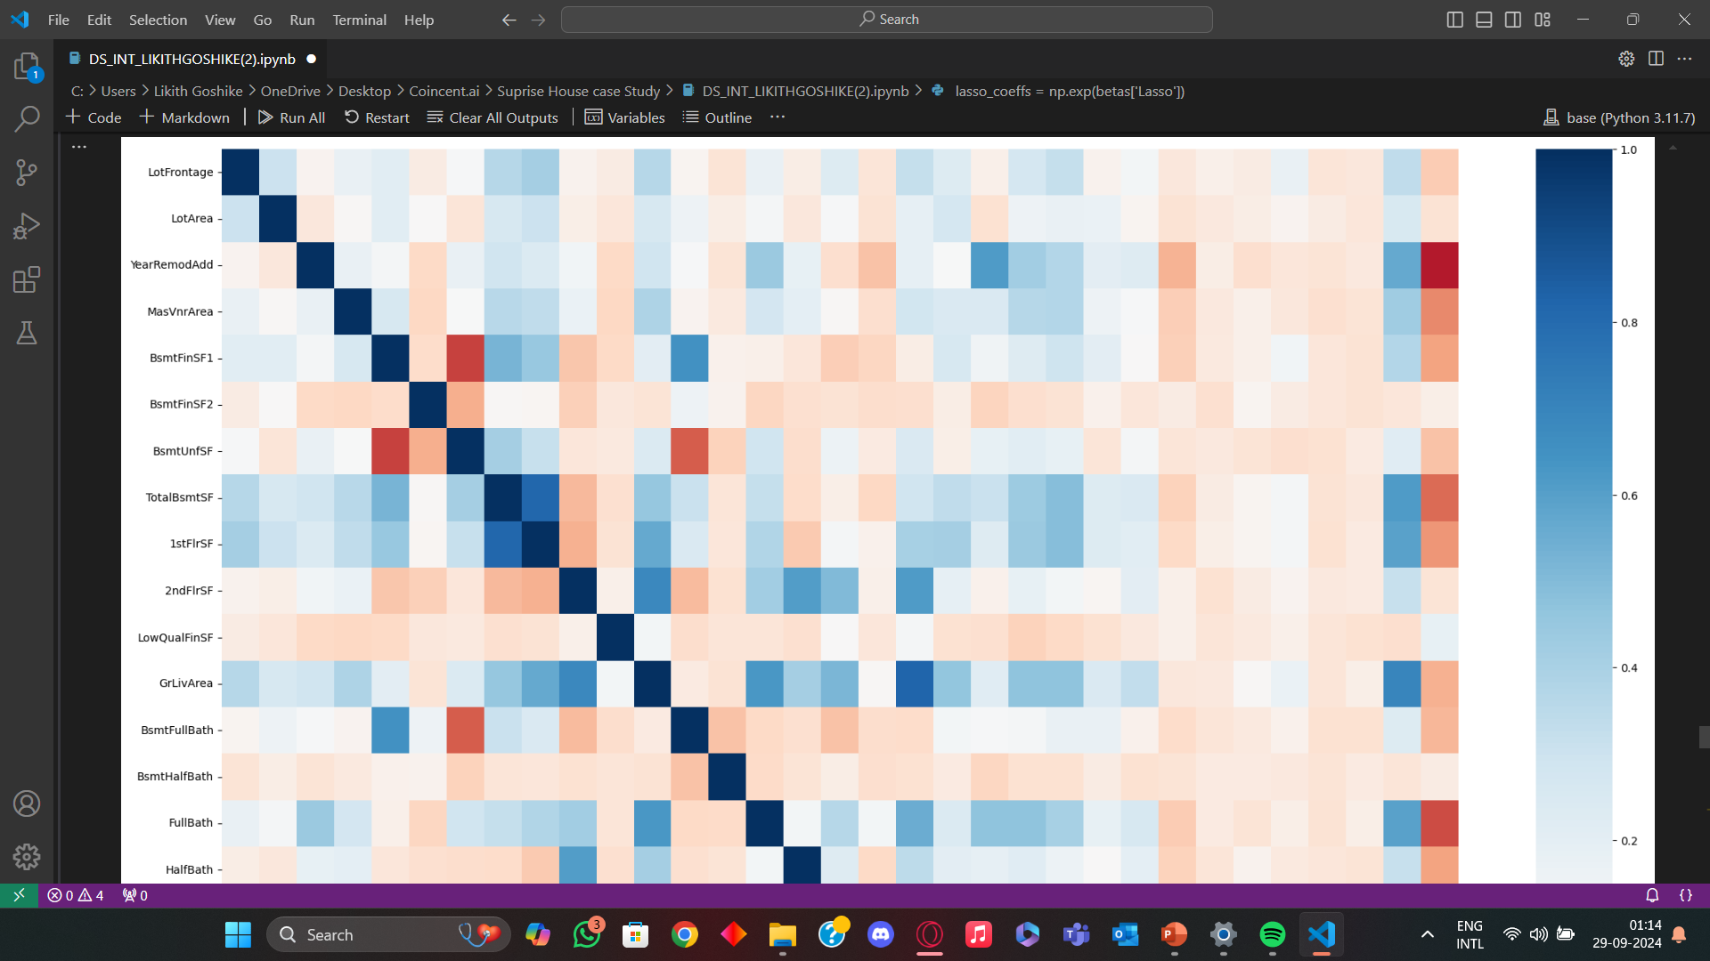
CODE

Slide 23
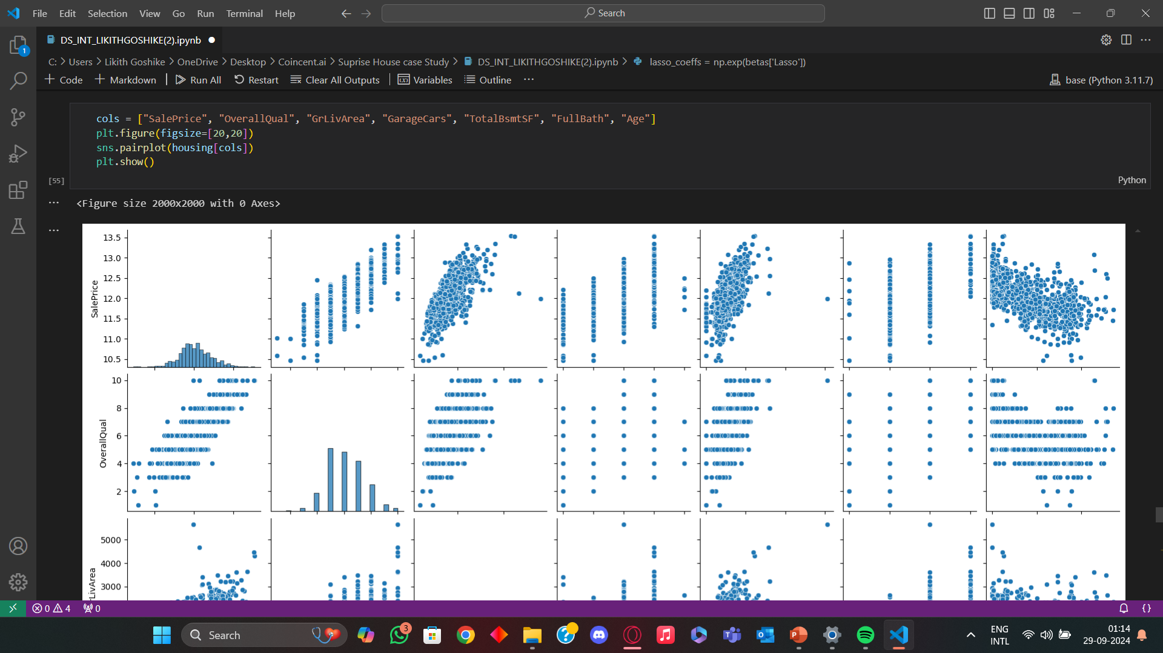
CODE

Slide 24
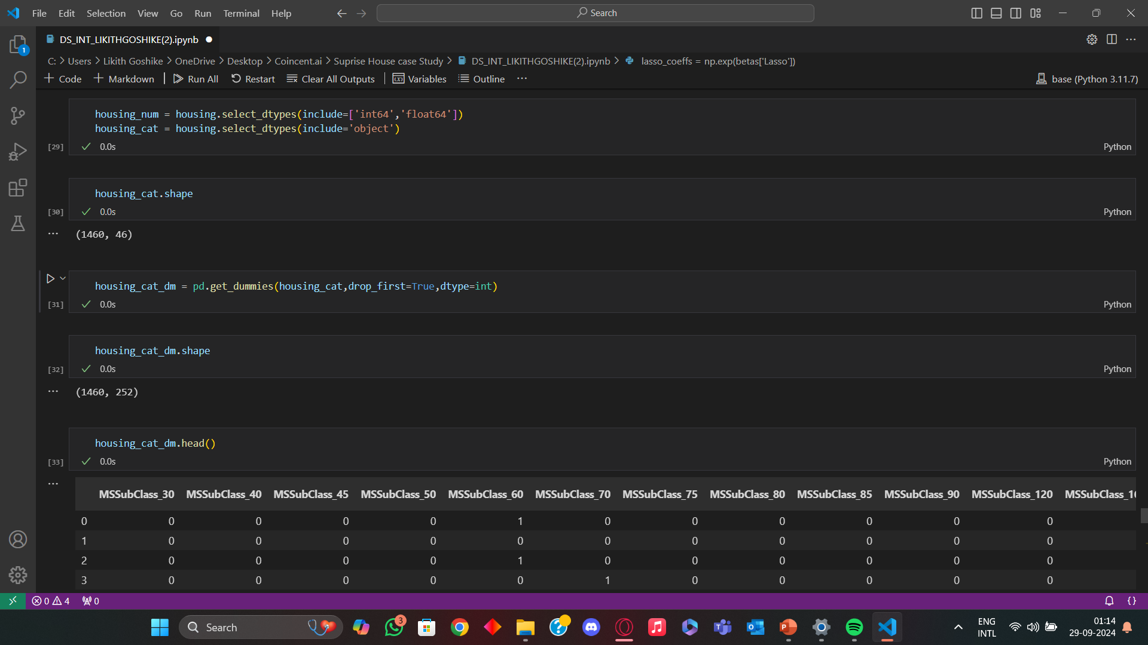
CODE

Slide 25
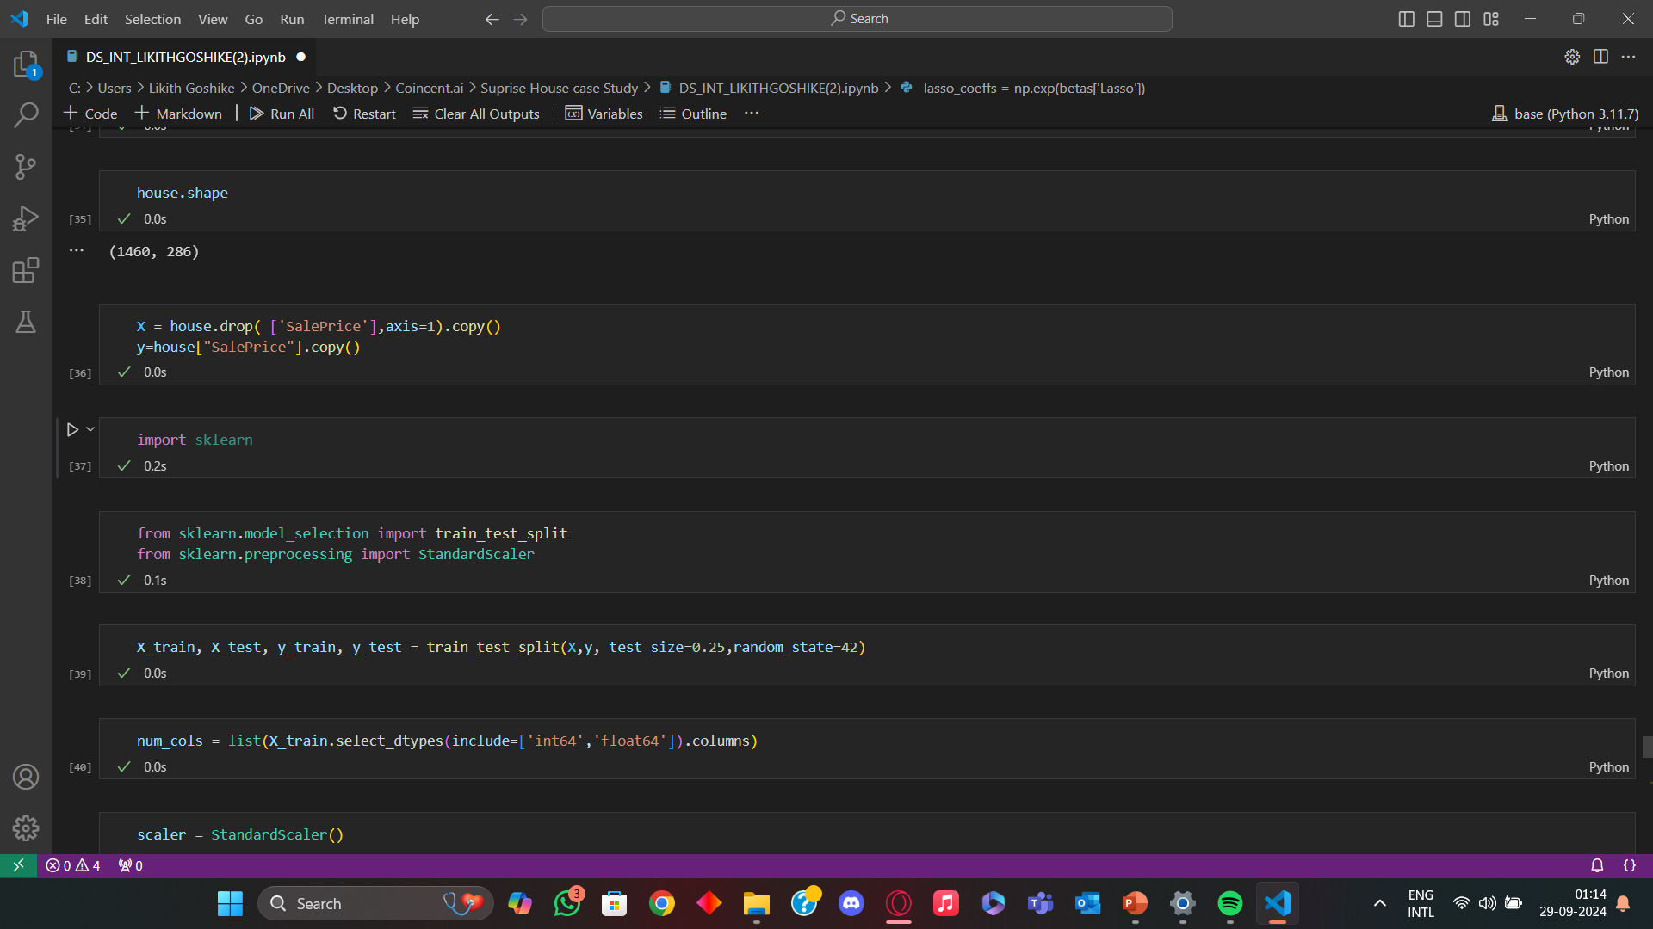
CODE

Slide 26
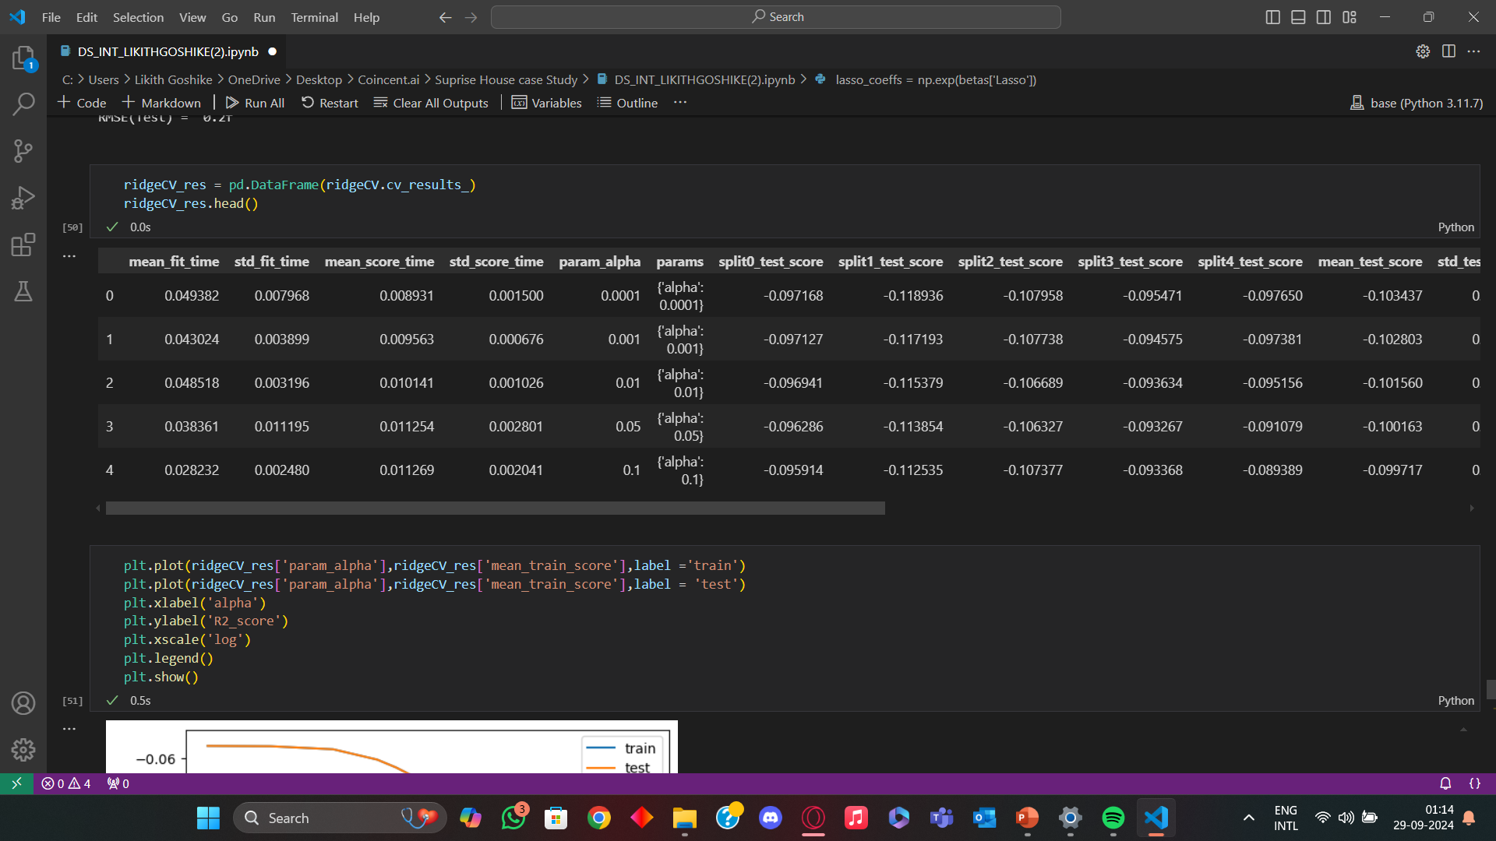
CODE

Slide 27
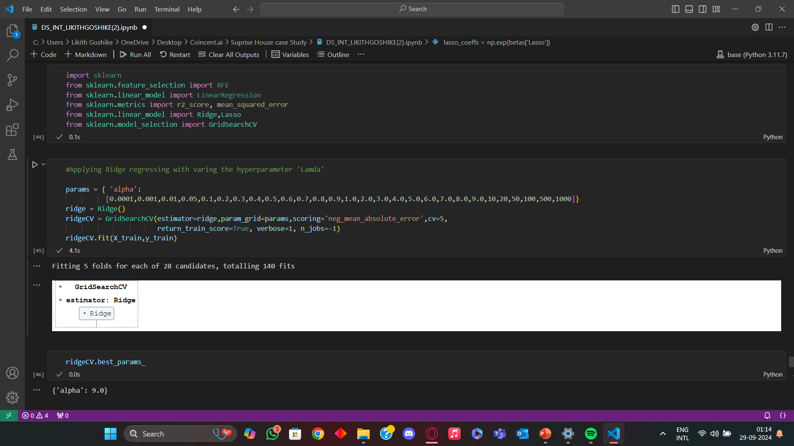
CODE

Slide 28
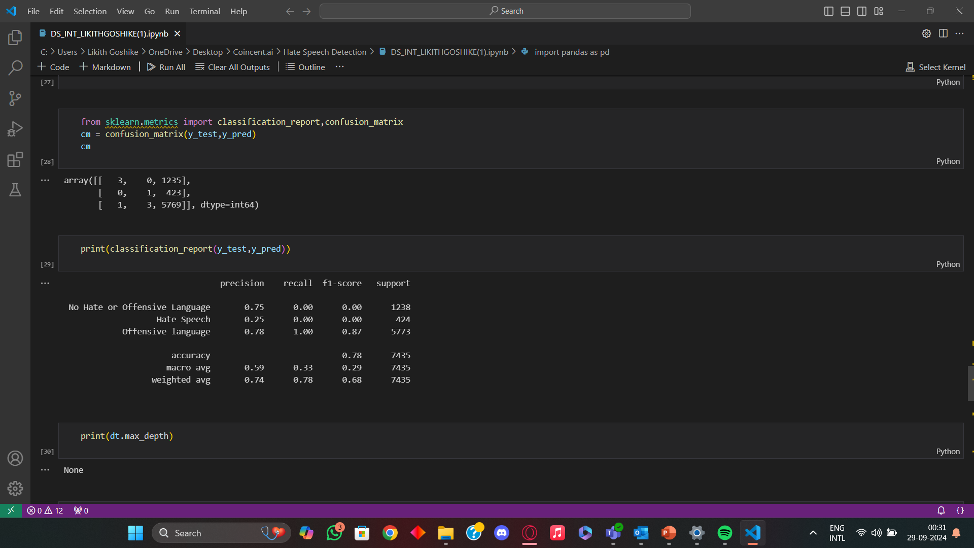
CODE

Slide 29
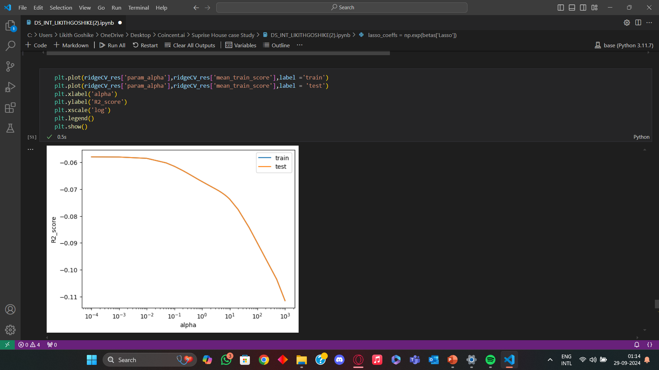
CODE

Slide 30
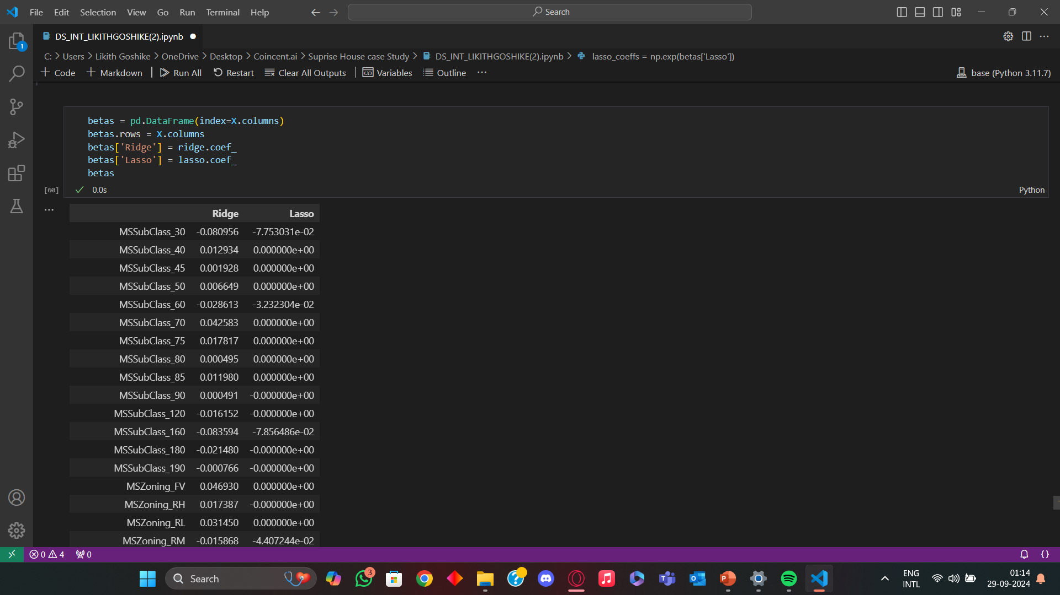
CODE

Slide 31
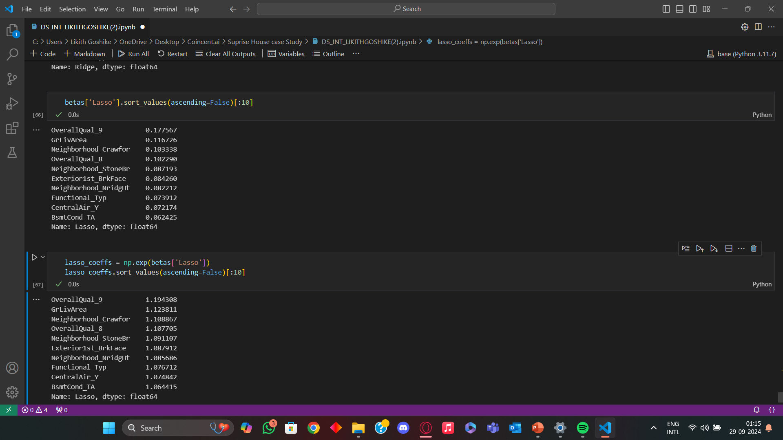
CODE

Slide 32
COnclusion
The application of machine learning in the "surprise house" case study demonstrates its powerful potential in transforming traditional real estate decision-making processes. By leveraging predictive models, we were able to generate insights about house pricing, customer preferences, and potential surprises in market trends that would be difficult to discern through conventional methods.
Machine learning algorithms such as regression, clustering, and decision trees allowed for detailed analysis of various factors like location, house features, market conditions, and even potential hidden risks, which buyers or sellers might otherwise overlook. The model’s ability to predict the most desirable features and anticipate unexpected cost fluctuations provided stakeholders with a competitive advantage.
Despite the advantages, some challenges were noted, such as the model’s reliance on high-quality data. Inconsistent or incomplete datasets limited the accuracy of the predictions. Moreover, the interpretability of certain machine learning models posed a challenge for real estate professionals who might not be familiar with advanced technical concepts.
In future iterations, incorporating more robust data preprocessing techniques and exploring explainable AI approaches could make machine learning applications more accessible and effective in this context. Overall, this case study highlights the immense potential of machine learning in transforming how we approach and understand the complexities of the housing market.

